Slide 1


Adorn your inner world with
VARENYA INTERIOR
Interior that reflects your style

Slide 2
Contents Page No.
Our Policy 4
Dealer Details 5
Interior Design 6-30
Membrane 31-35
Lacquered Glass 36-49
Acrylic 50-53
PU Shutter 54-57

Slide 3
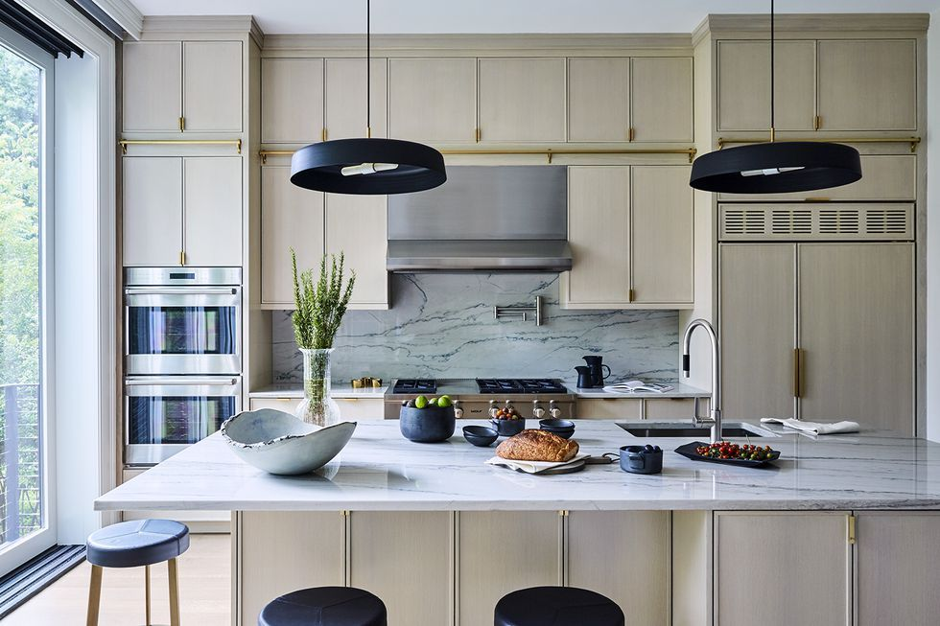
www.varenyainteriors.com WhatsApp +919582874024

Slide 4
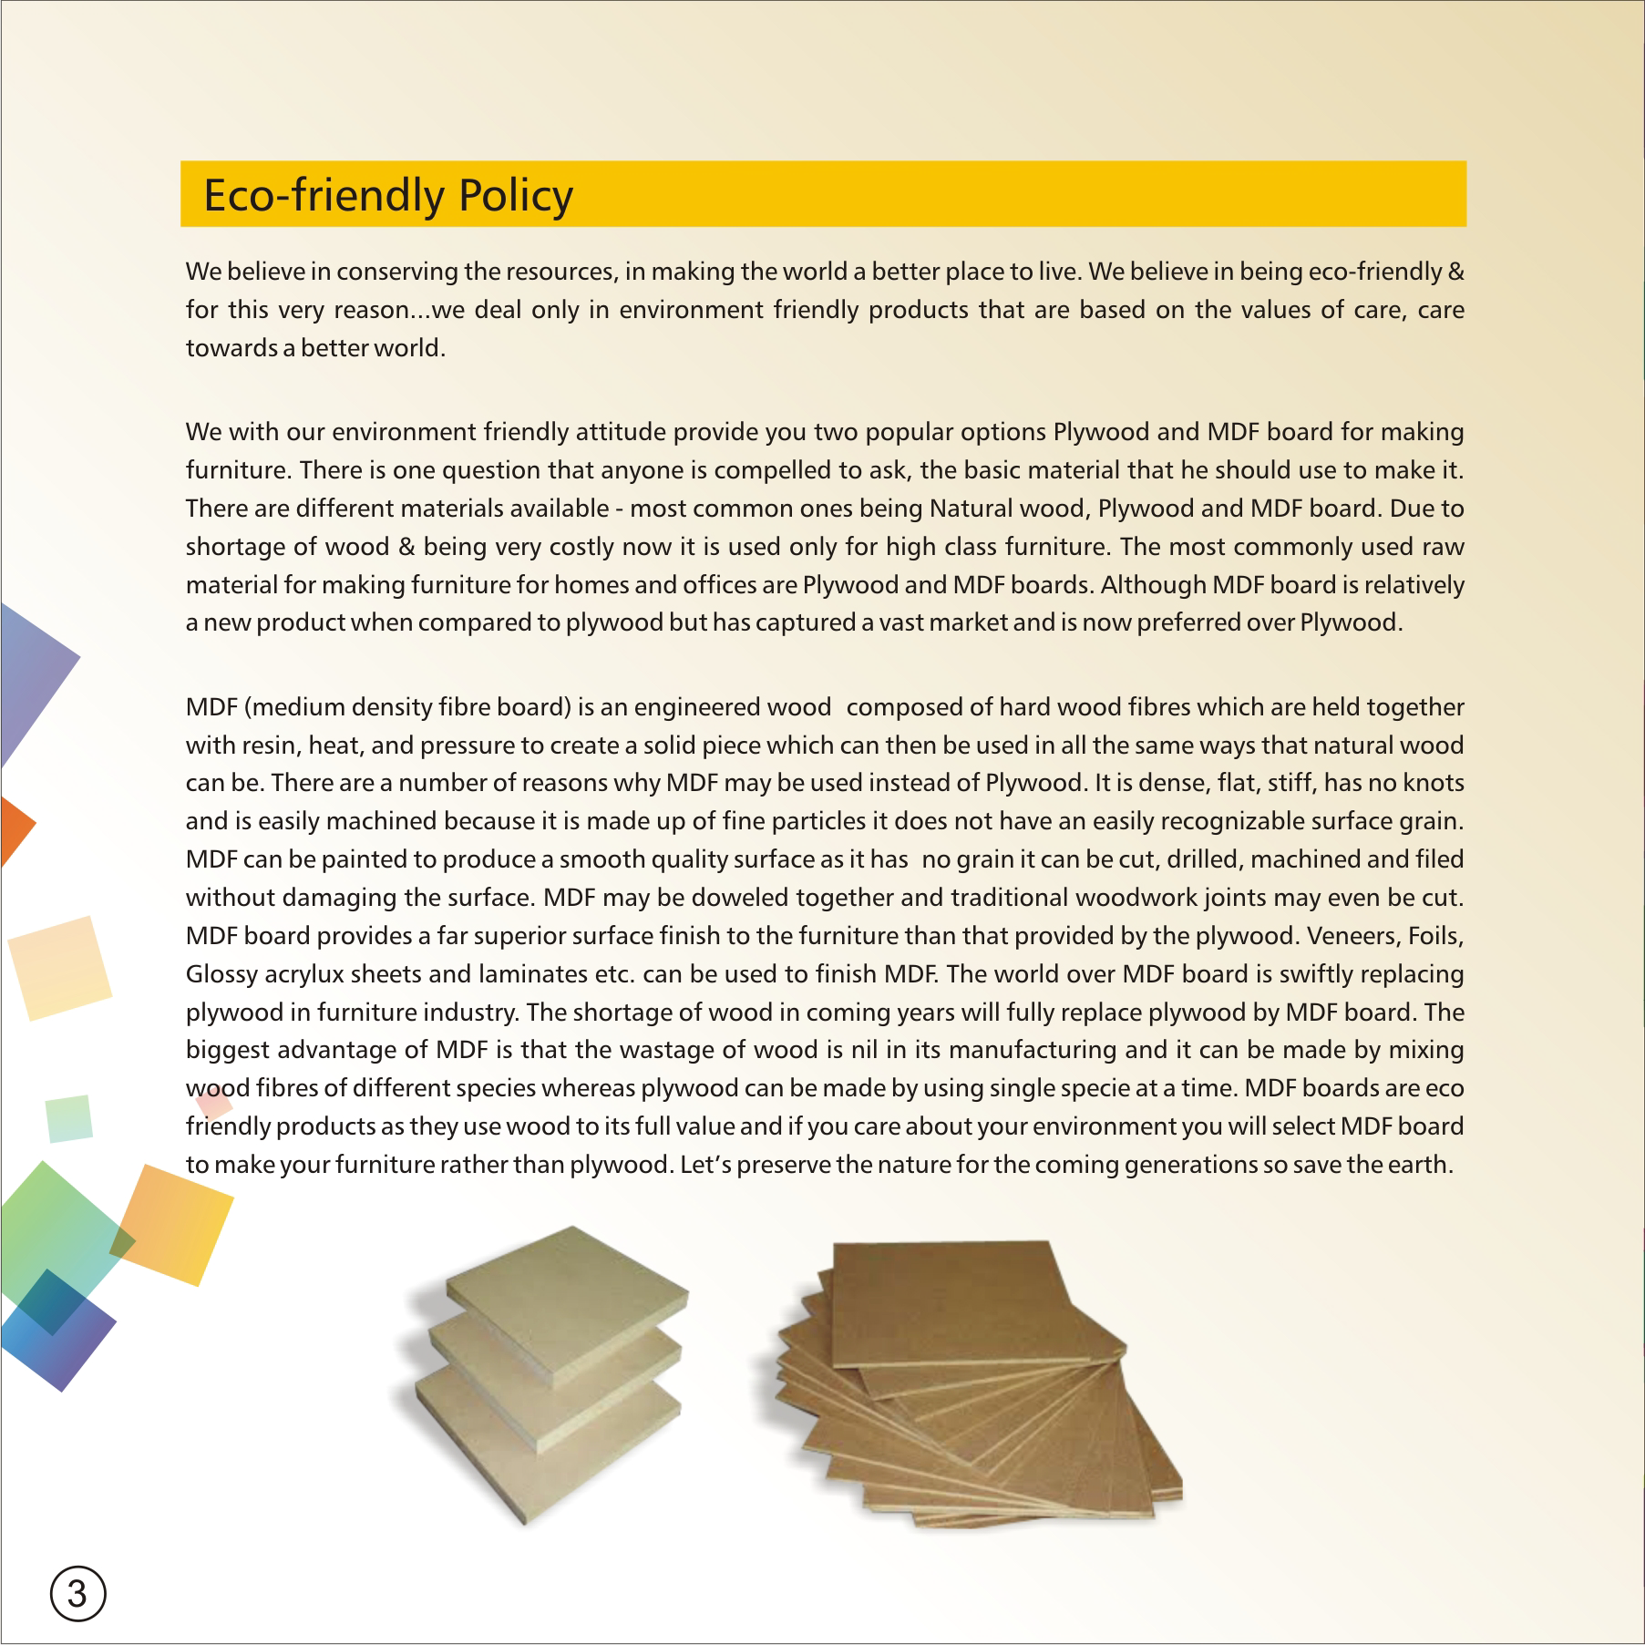

Slide 5
Dealer Details
Bangalore
Chandigarh
Delhi
Gurugram
Haridwar
Hyderabad
Jaipur
Jammu
Kolkata
Lucknow
Ludhiana
Mohali
Mumbai
Muradabad
Panchkula
Pune
Siliguri
Srinagar

Slide 6

















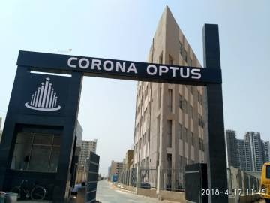



Retail Project

Slide 7
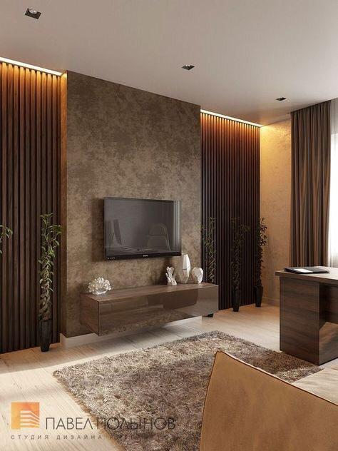
Living Room Design
www.varenyainteriors.com Mobile/WhatsApp-+919582874024

Slide 8
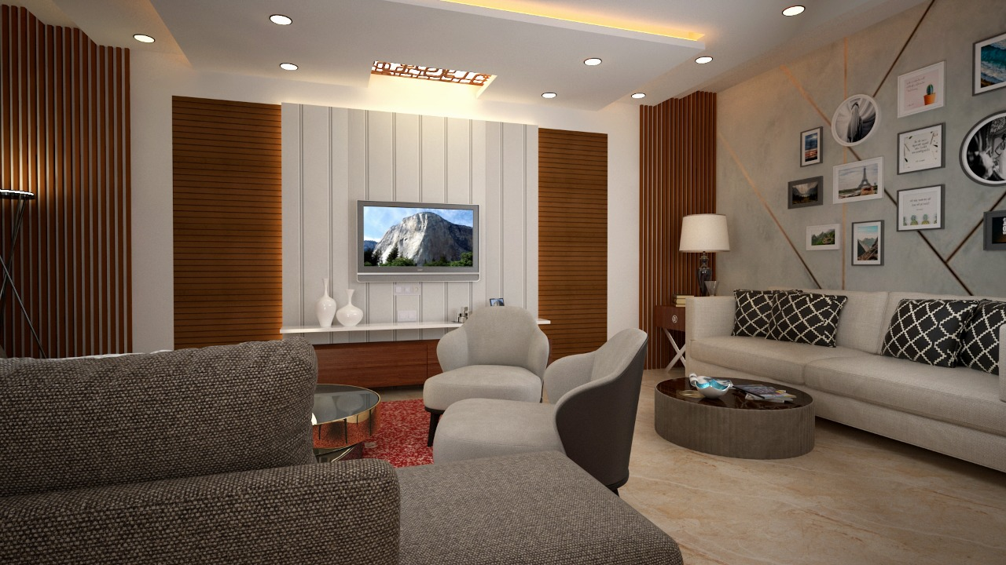
Living Room Design
www.varenyainteriors.com Mobile/WhatsApp-+919582874024

Slide 9
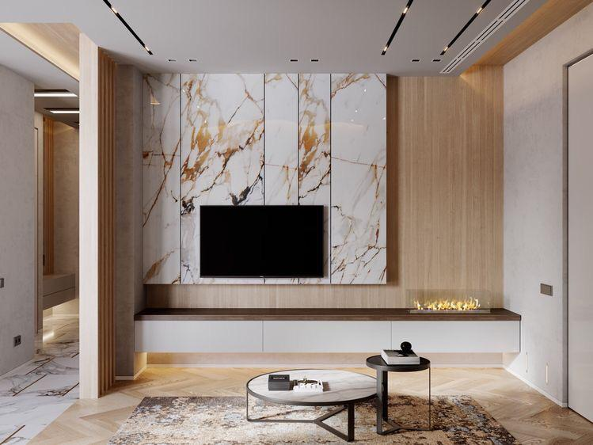
Living Room Design
www.varenyainteriors.com Mobile/WhatsApp-+919582874024

Slide 10
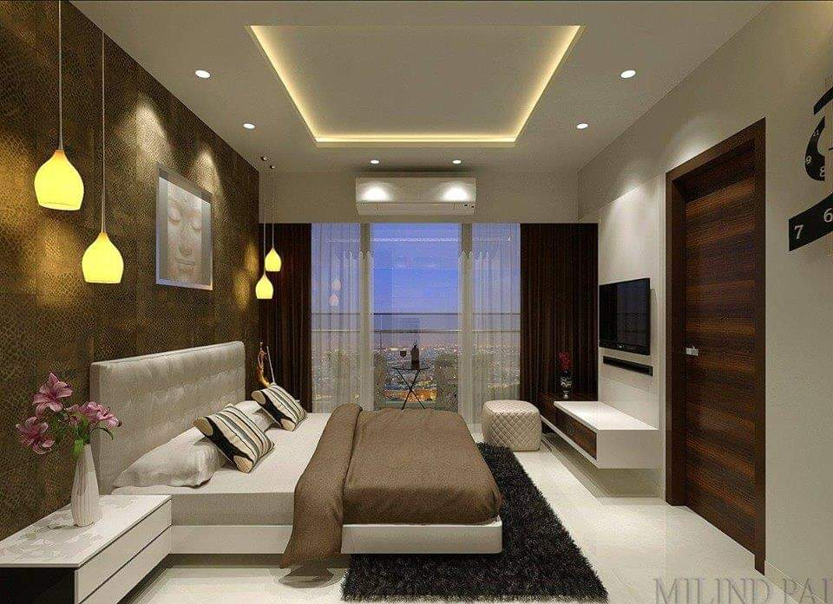
Bedroom Design
www.varenyainteriors.com Mobile/WhatsApp-+919582874024

Slide 11
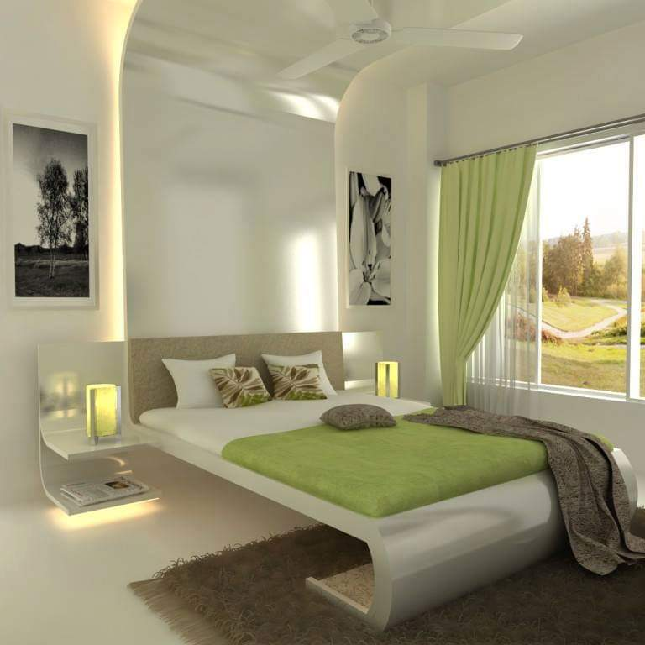
Bedroom Design
www.varenyainteriors.com Mobile/WhatsApp-+919582874024

Slide 12
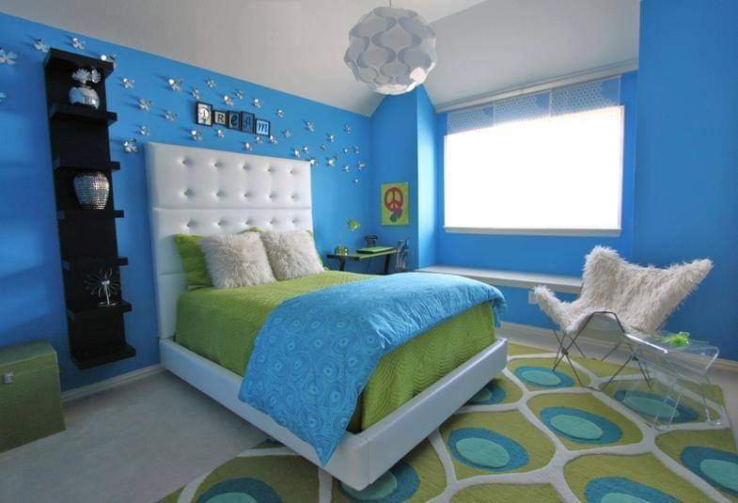
Kid’s Room Design
www.varenyainteriors.com Mobile/WhatsApp-+919582874024

Slide 13
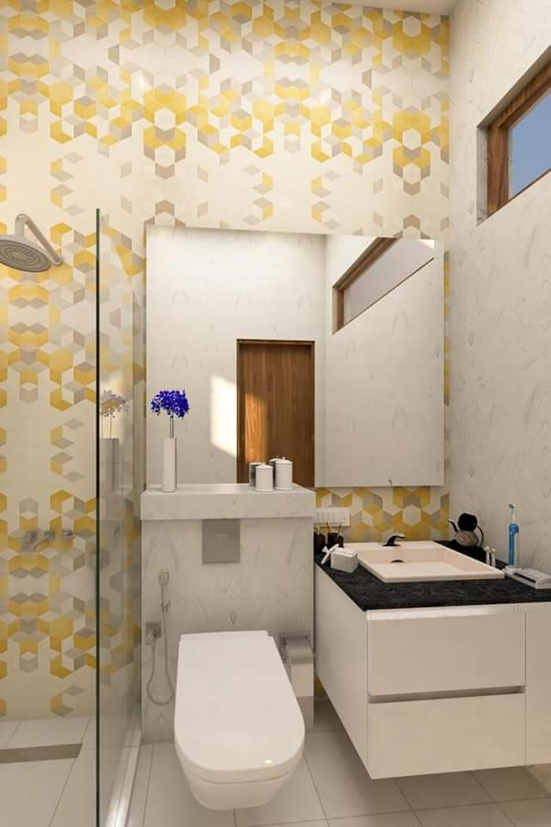
Bathroom Design
www.varenyainteriors.com Mobile/WhatsApp-+919582874024

Slide 14
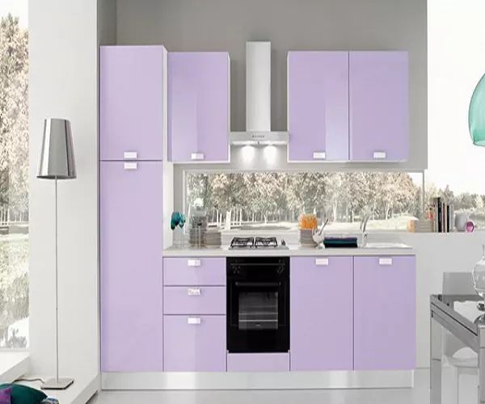
1`
Laminate Kitchen
www.varenyainteriors.com Mobile/WhatsApp:+919582874024

Slide 15
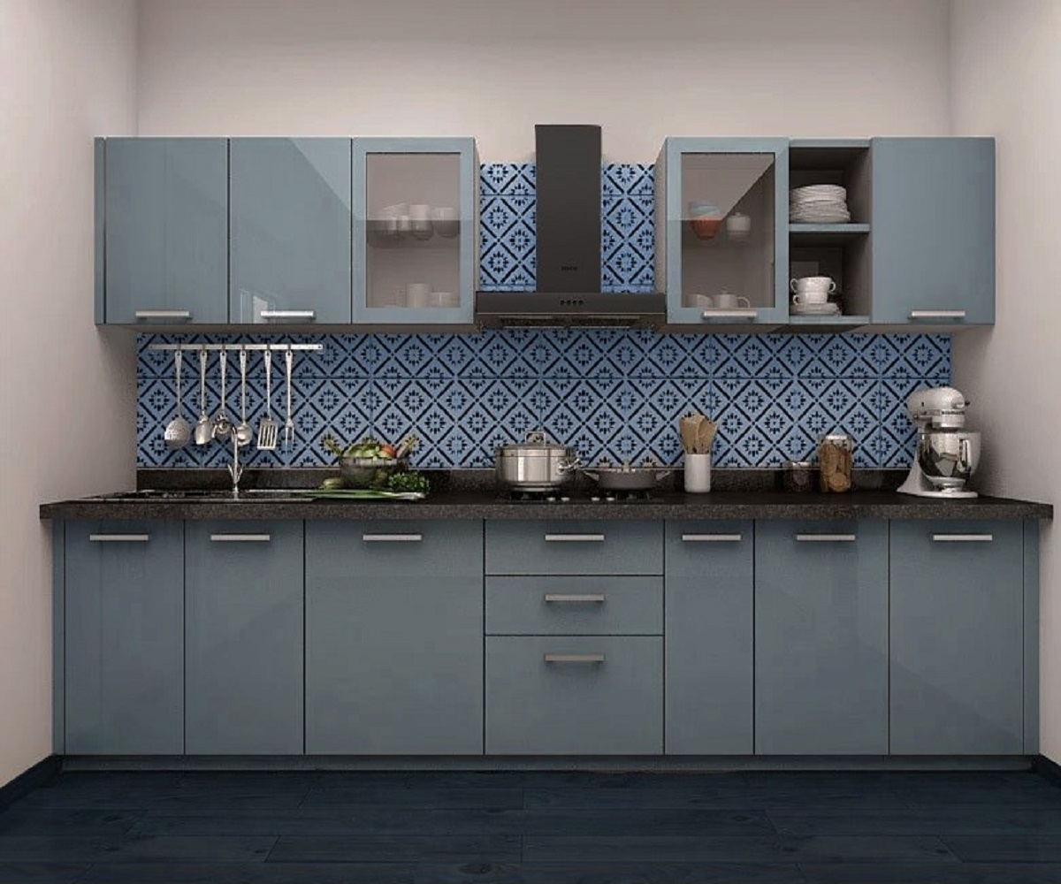
Acrylic Kitchen
www.varenyainteriors.com Mobile/WhatsApp:+919582874024

Slide 16
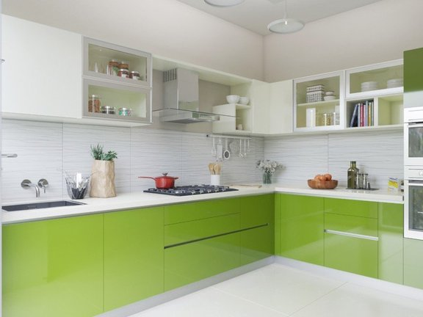
PU Kitchen
www.varenyainteriors.com Mobile/Whatsapp:+919582874024

Slide 17
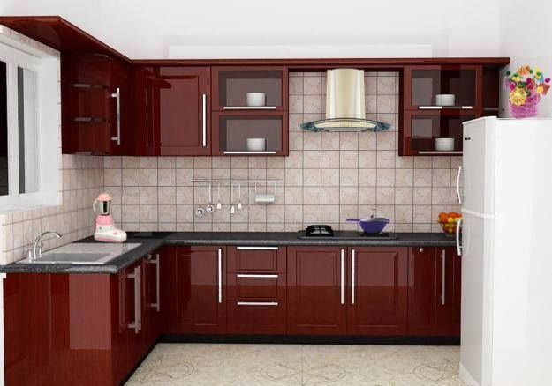
Membrane Kitchen
www.varenyainteriors.com Mobile/Whatsapp:+919582874024

Slide 18
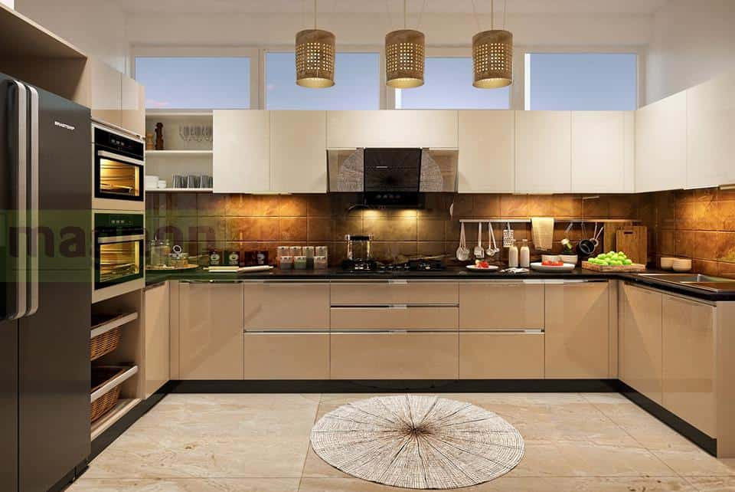
Lacquered Glass Kitchen
www.varenyainteriors.com Mobile/Whatsapp:+919582874024

Slide 19
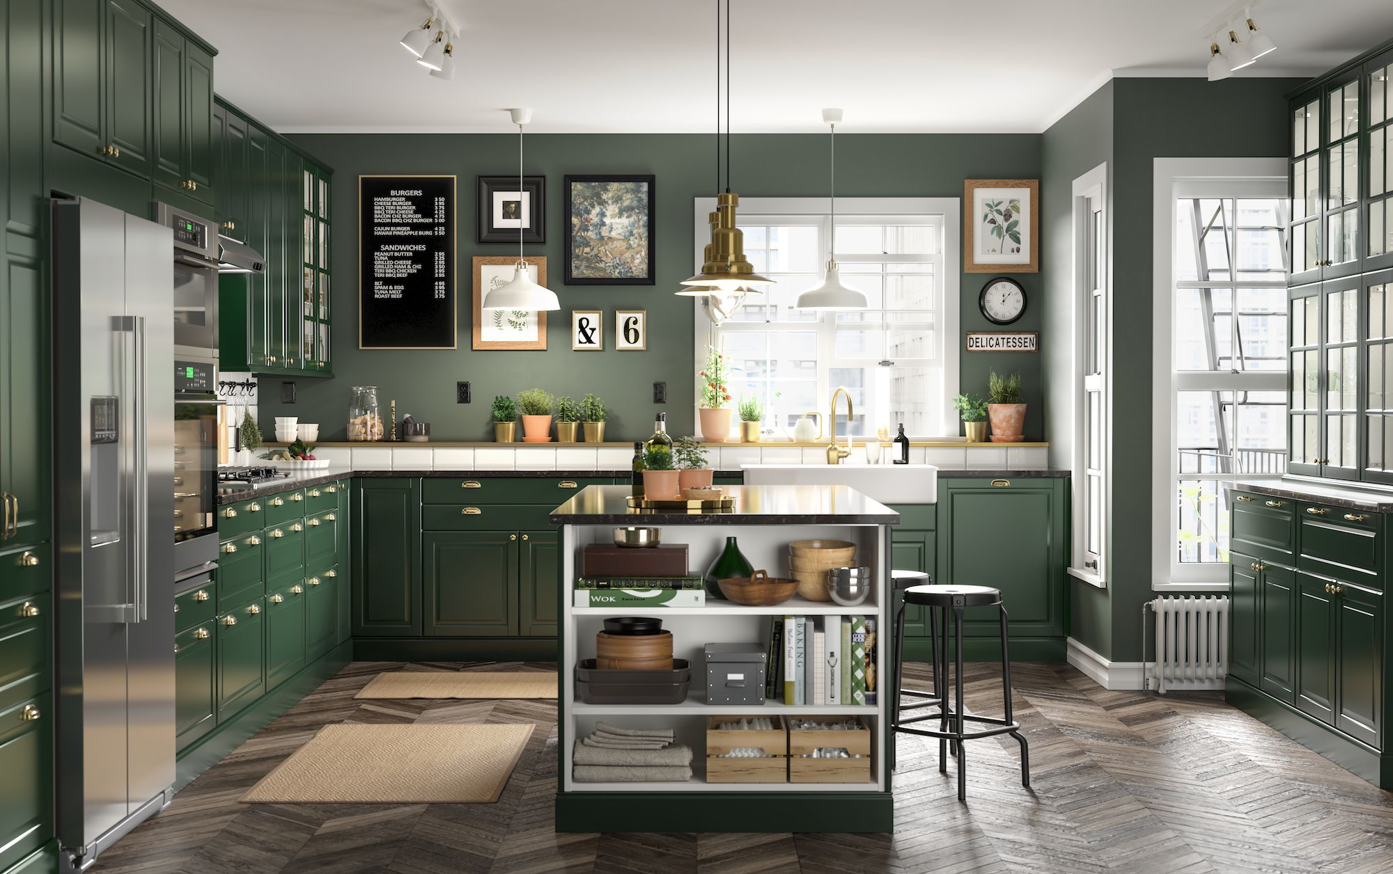
PU Kitchen
www.varenyainteriors.com Mobile/Whatsapp:+919582874024

Slide 20
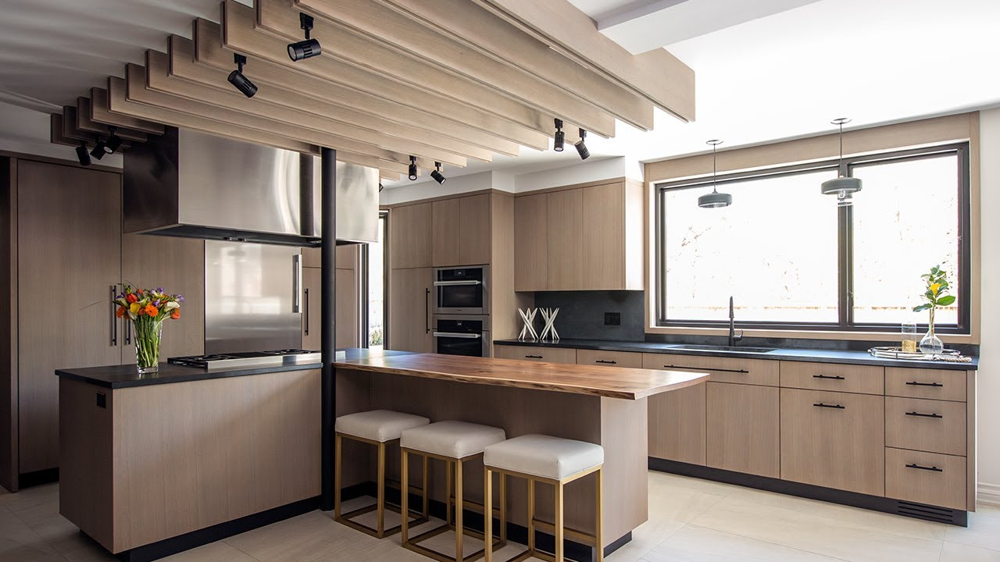
A
Acrylic Kitchen
www.varenyainteriors.com Mobile/Whatsapp:+919582874024

Slide 21
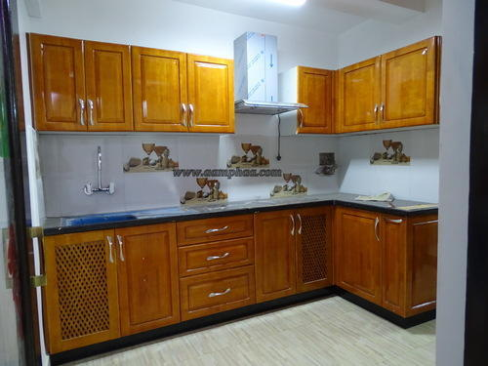
Hardwood Kitchen
www.varenyainteriors.com Mobile/Whatsapp:+919582874024

Slide 22
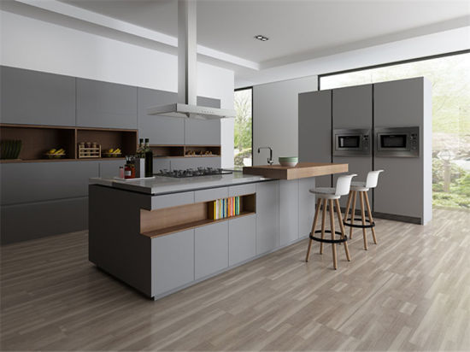
PU Kitchen
www.varenyainteriors.com Mobile/Whatsapp:+919582874024

Slide 23
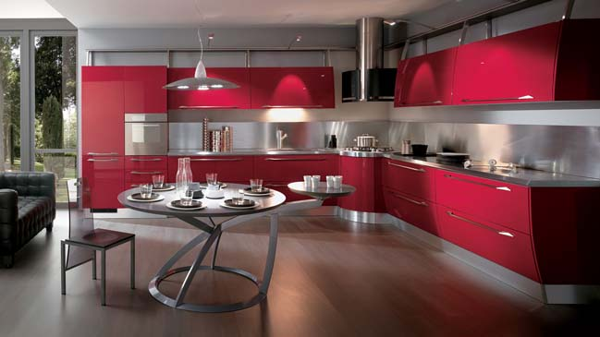
Acrylic Kitchen
www.varenyainteriors.com Mobile/Whatsapp:+919582874024

Slide 24
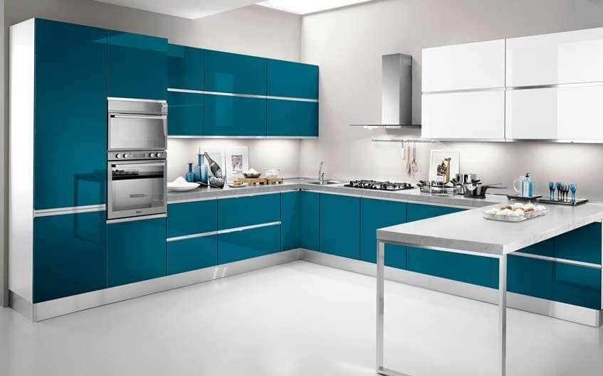
Acrylic Kitchen
www.varenyainteriors.com Mobile/Whatsapp:+919582874024

Slide 25
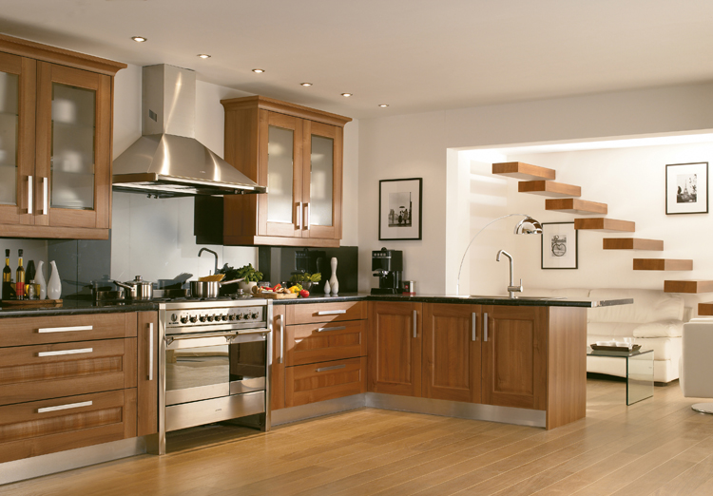
Membrane Kitchen
www.varenyainteriors.com Mobile/Whatsapp:+919582874024

Slide 26
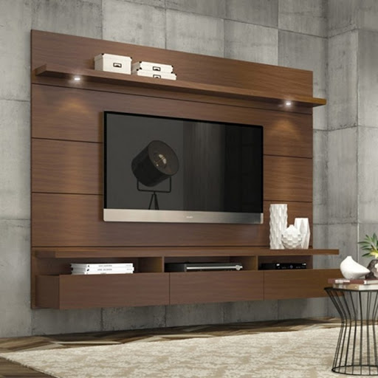
Laminate LCD Unit
www.varenyainteriors.com Mobile/Whatsapp:+919582874024

Slide 27
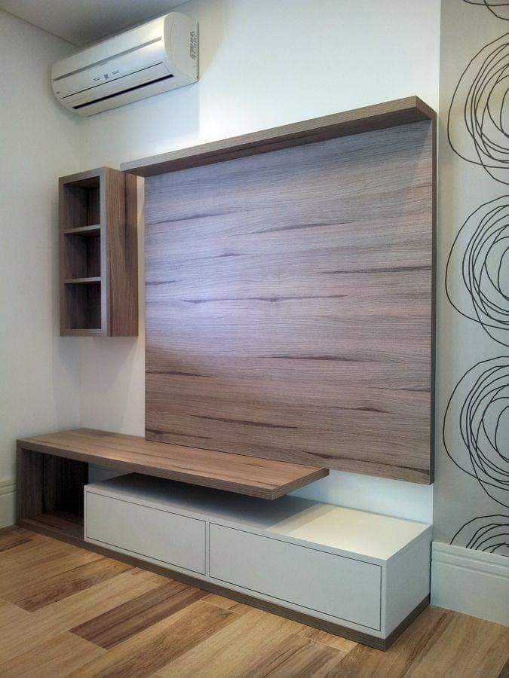
Laminate LCD Unit
www.varenyainteriors.com Mobile/Whatsapp:+919582874024

Slide 28
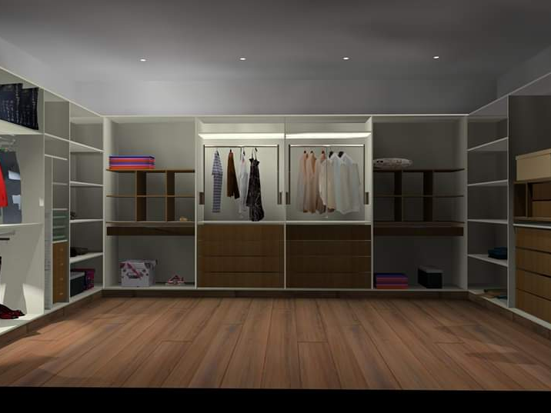
Wardrobe Design
www.varenyainteriors.com Mobile/Whatsapp:+919582874024

Slide 29
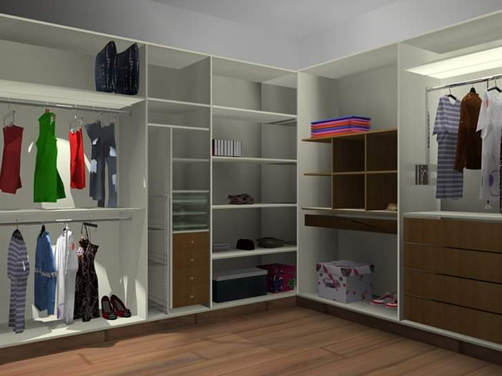
Wardrobe Design
www.varenyainteriors.com Mobile/Whatsapp:+919582874024

Slide 30
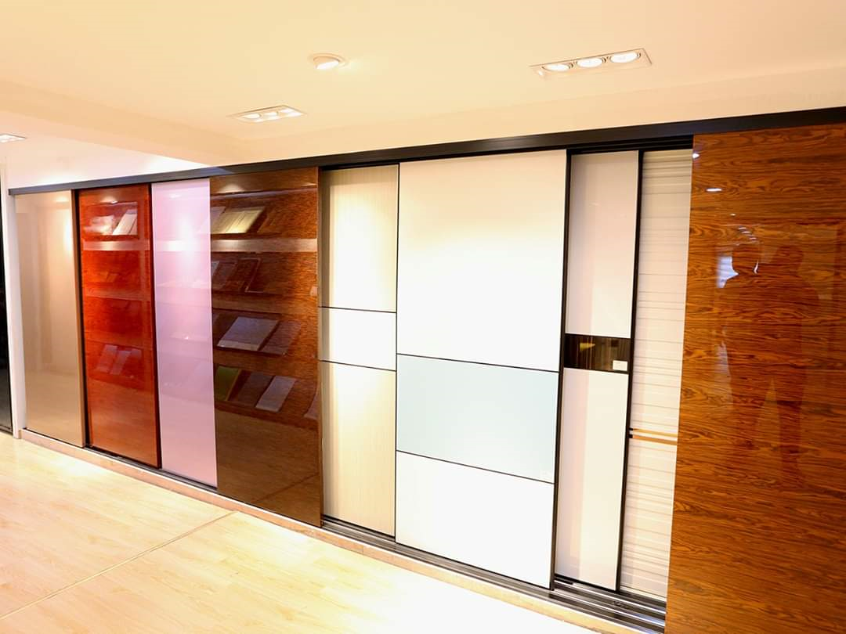
Various Kinds of Sliding Doors
www.varenyainteriors.com Mobile/Whatsapp:+919582874024

Slide 31
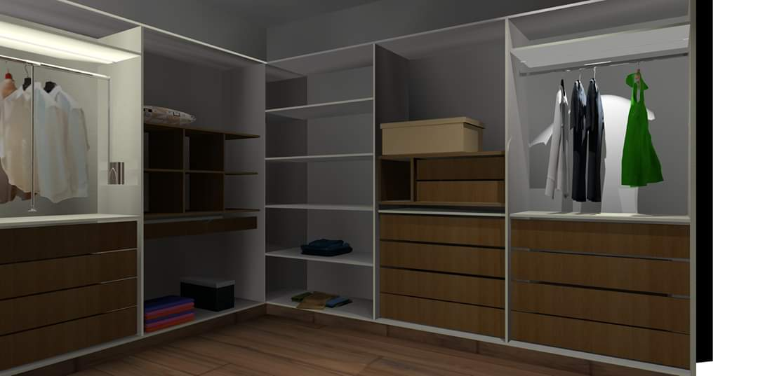
Wardrobe Design
www.varenyainteriors.com Mobile/Whatsapp:+919582874024

Slide 32
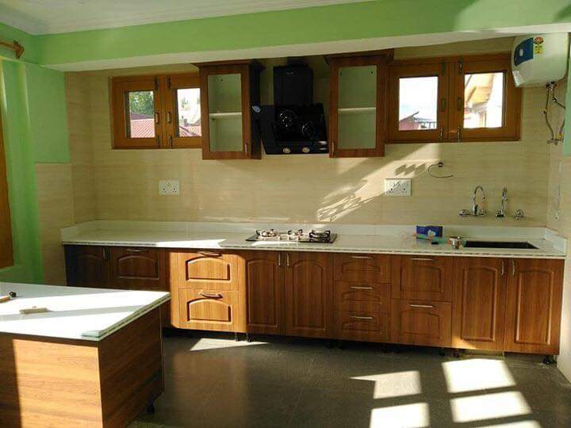
MEMBRANE SHUTTER
MADE BY DESIGN CODE
DESIGN CODE
THE DREAM INGREDIENT FOR A DESIGNER
KITCHEN
www.varenyainteriors.com Mobile/Whatsapp:+919582874024

Slide 33
Membrane
Polyvinyl Chloride foil
Water and weather resistant- ideal for kitchens
Durable and has great shelf life
Available in glossy and matte finish
Cleaning is easy with a moist cloth and mild detergent
No edge banding is required as it easily wraps around the sides
Offers a smooth finish for modular products
Economical when compared to others

Slide 34





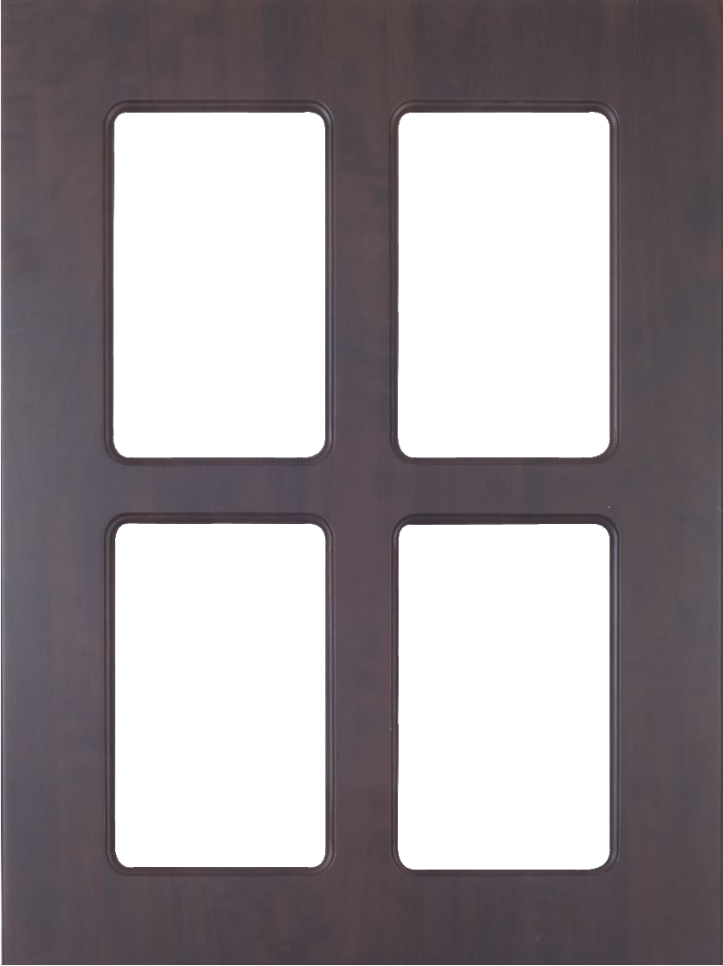
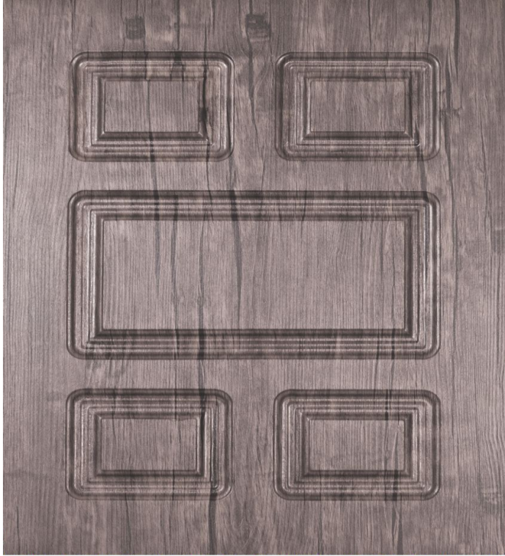

VI-002
VI-003
VI-001
VI-004
VI-005
VI-006
www.varenyainteriors.com Mobile/Whatsapp:+919582874024

Slide 35
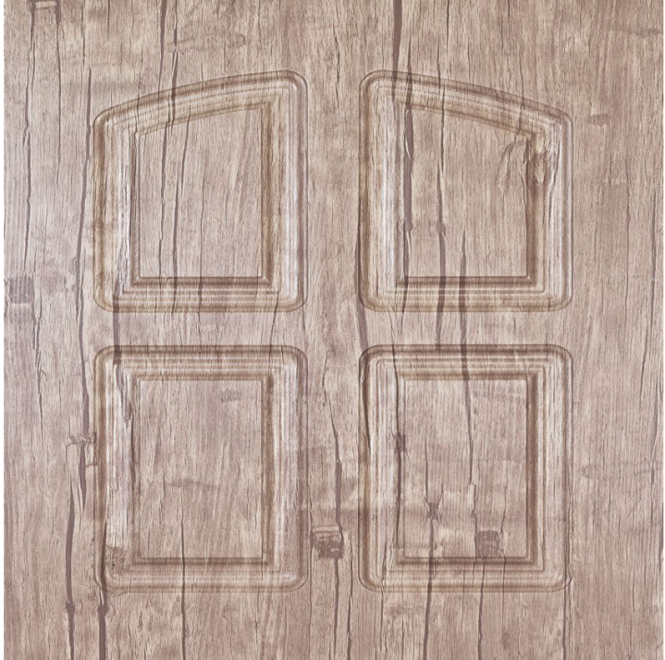

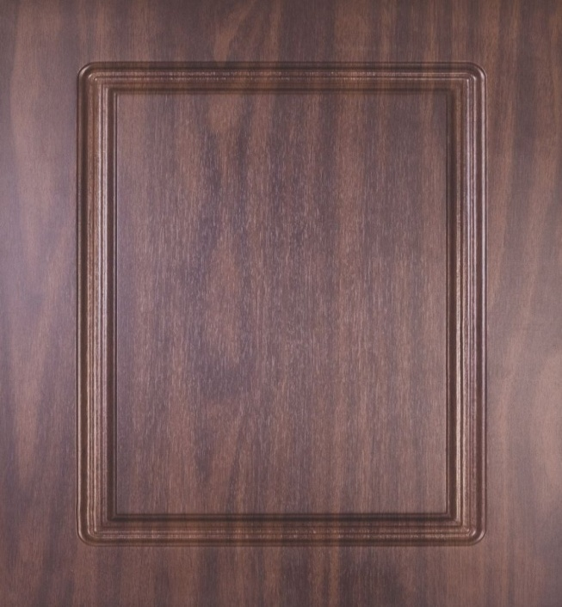
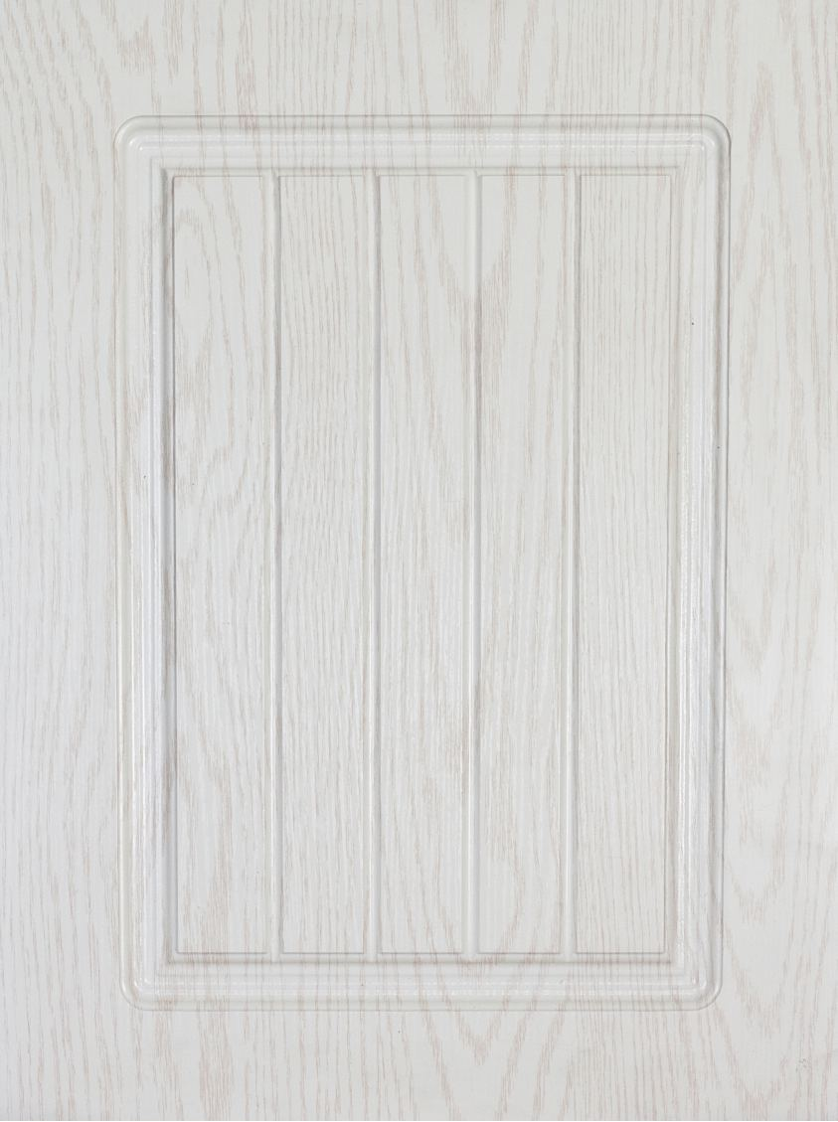
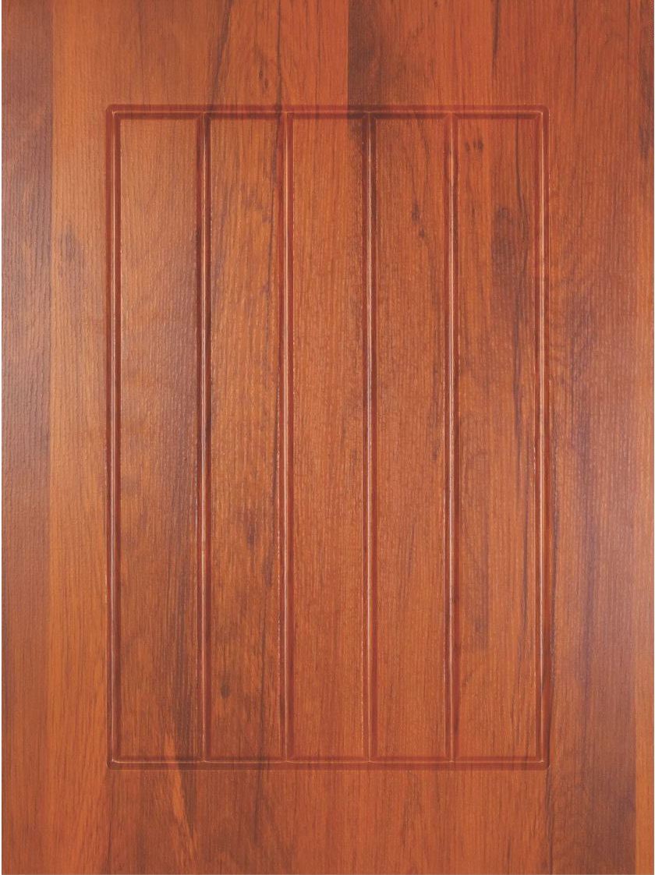
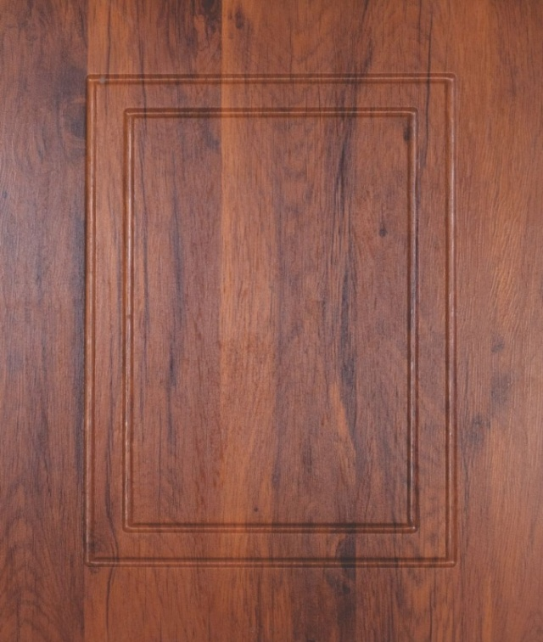
VI-007
VI-008
VI-009
VI-010
VI-011
VI-012
www.varenyainteriors.com Mobile/Whatsapp:+919582874024

Slide 36
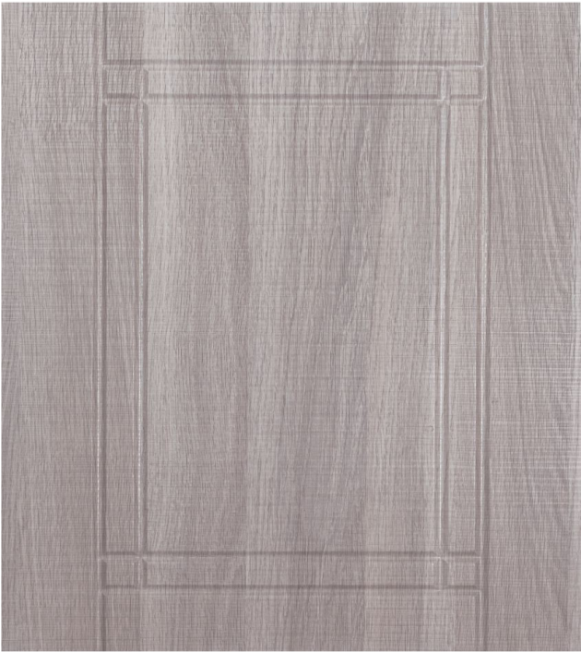

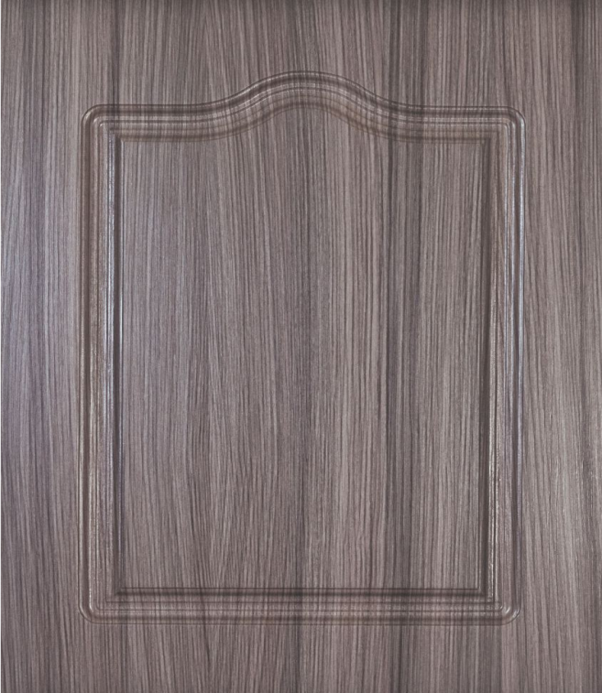
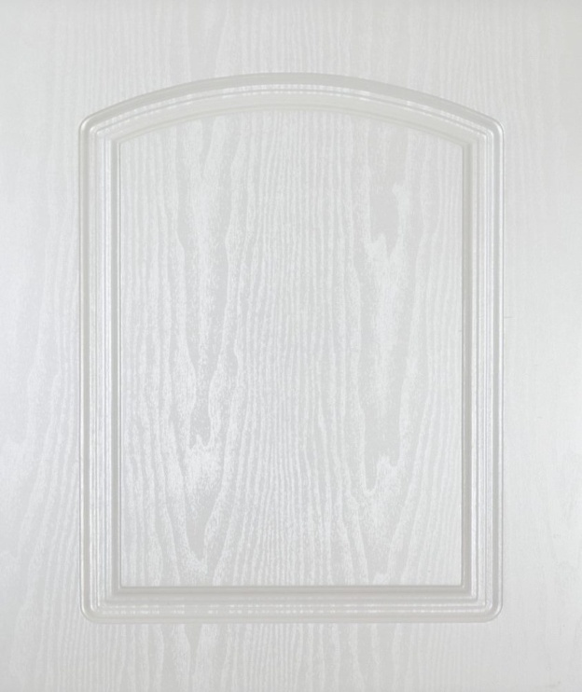
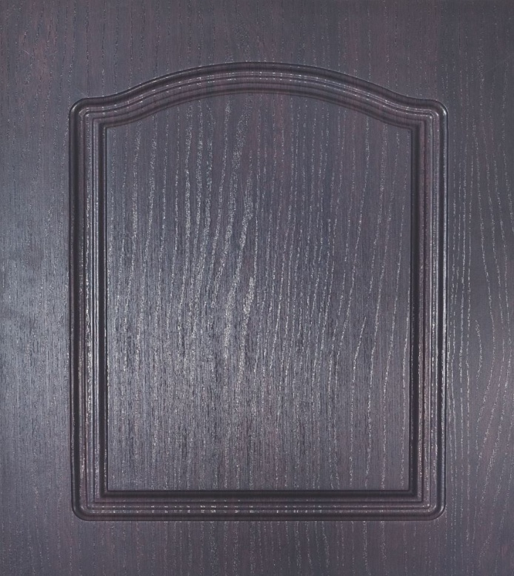
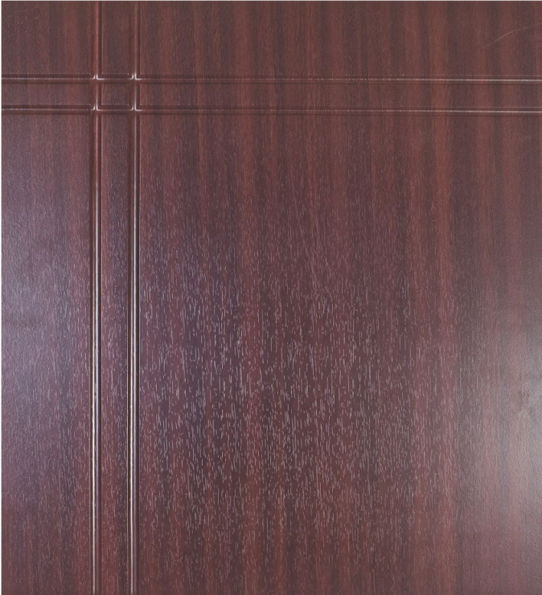
VI-013
VI-015
VI-016
VI-017
VI-018
VI-020
www.varenyainteriors.com Mobile/Whatsapp:+919582874024

Slide 37
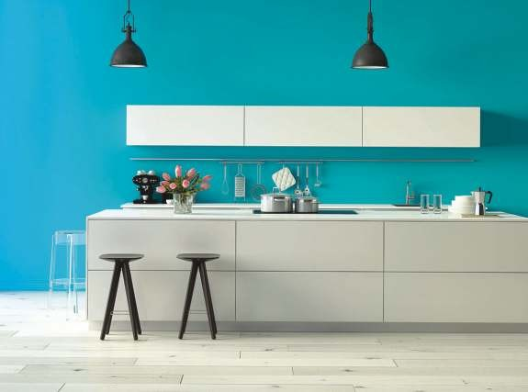



THE DREAM INGREDIENT FOR DESIGNER
COLOR CODE
KITCHEN
www.varenyainteriors.com Mobile/Whatsapp:+919582874024

Slide 38
Lacquered Glass
Solution of film-forming(natural or synthetic)
Brings color and ambiance to interiors
Animates surroundings with reflections and brilliance
Durable and provides flawless finish
Resistant to humidity
Serves the purpose of a safety glass
Maintains a clean and non-polluted environment

Slide 39
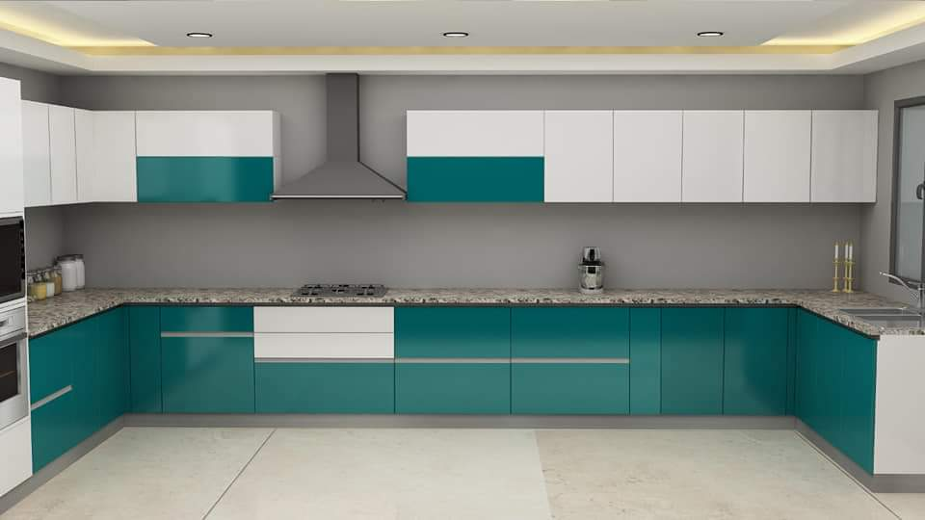
Lacquered Glass Kitchen
www.varenyainteriors.com Mobile/Whatsapp:+919582874024

Slide 40




















COOL EARTH SG (G)
EXTRA WHITE SG (G)
BROWN SG (G)
OPERA RED SG(G)
CALM SKY SG (G)
OLIVE GREEN SG (G)
PURPLE SG (G)
MINT GREEN SG (G)
YELLOW SG (G)
ALMOND GREEN SG(G)
FLAME RED SG (G)
ORANGE SG (G)
ATOLL BLUE SG (G)
AQUA BLUE SG (G)
PISTA GREEN SG (G)
TITANIUM GRAY SG(G)
BLACK DM (G)
NEON GREEN DM (G)
CLASSIC IVORY DM (G)
WHITE DM (G)
www.varenyainteriors.com Mobile/Whatsapp:+919582874024

Slide 41




COOL EARTH SG (G)
EXTRA WHITE SG (G)
www.varenyainteriors.com Mobile/Whatsapp:+919582874024

Slide 42

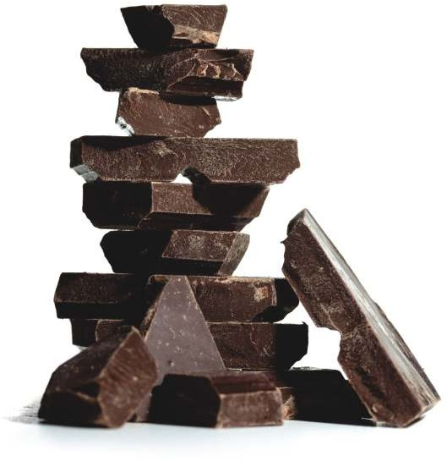


BROWN SG (G)
OPERA RED SG(G)
www.varenyainteriors.com Mobile/Whatsapp:+919582874024

Slide 43




CALM SKY SG (G)
OLIVE GREEN SG (G)
www.varenyainteriors.com Mobile/Whatsapp:+919582874024

Slide 44




PURPLE SG (G)
MINT GREEN SG (G)
www.varenyainteriors.com Mobile/Whatsapp:+919582874024

Slide 45


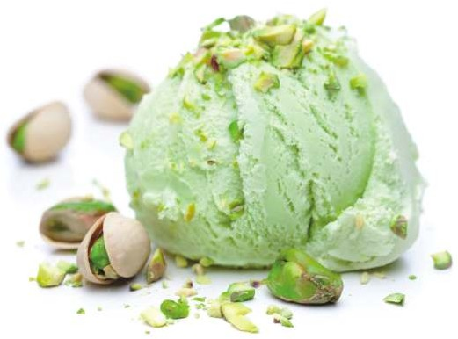

YELLOW SG (G)
ALMOND GREEN SG(G)
www.varenyainteriors.com Mobile/Whatsapp:+919582874024

Slide 46




FLAME RED SG (G)
ORANGE SG (G)
www.varenyainteriors.com Mobile/Whatsapp:+919582874024

Slide 47

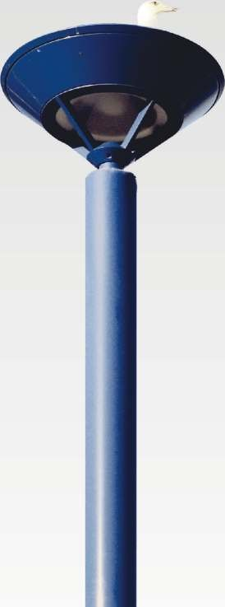


ATOLL BLUE SG (G)
AQUA BLUE SG (G)
www.varenyainteriors.com Mobile/Whatsapp:+919582874024

Slide 48




PISTA GREEN SG (G)
TITANIUM GRAY SG(G)
www.varenyainteriors.com Mobile/Whatsapp:+919582874024

Slide 49




BLACK DM (G)
NEON GREEN DM (G)
www.varenyainteriors.com Mobile/Whatsapp:+919582874024

Slide 50




CLASSIC IVORY DM (G)
WHITE DM (G)
www.varenyainteriors.com Mobile/Whatsapp:+919582874024

Slide 51
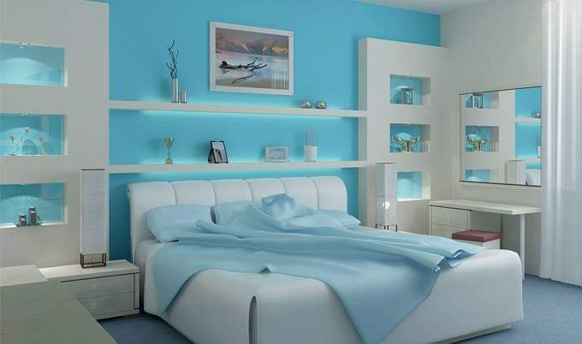
ACRYLIC SHUTTER
MADE BY CODE
COLOR CODE
THE DREAM INGREDIENT FOR A DESIGNER
BEDROOM
www.varenyainteriors.com Mobile/Whatsapp:+919582874024

Slide 52
Acrylic
Non-toxic , reflective high gloss finish
Available in a wide range of vibrant colors
Maintain smooth and glossy appearance
Gives aesthetic appeal and is easy to clean
Does not require extra care in regards to handling the material safely
Has great elasticity

Slide 53
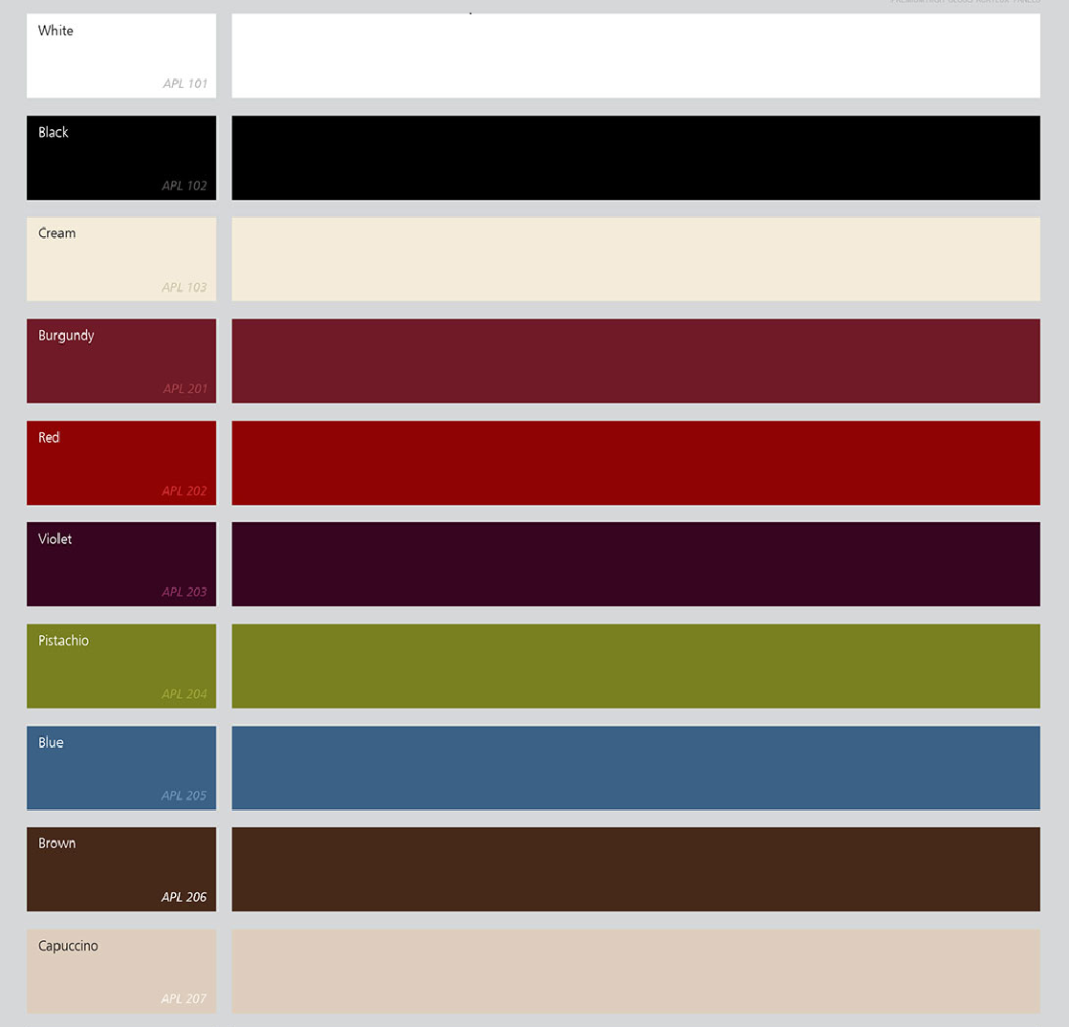
www.varenyainteriors.com Mobile/Whatsapp:+919582874024

Slide 54
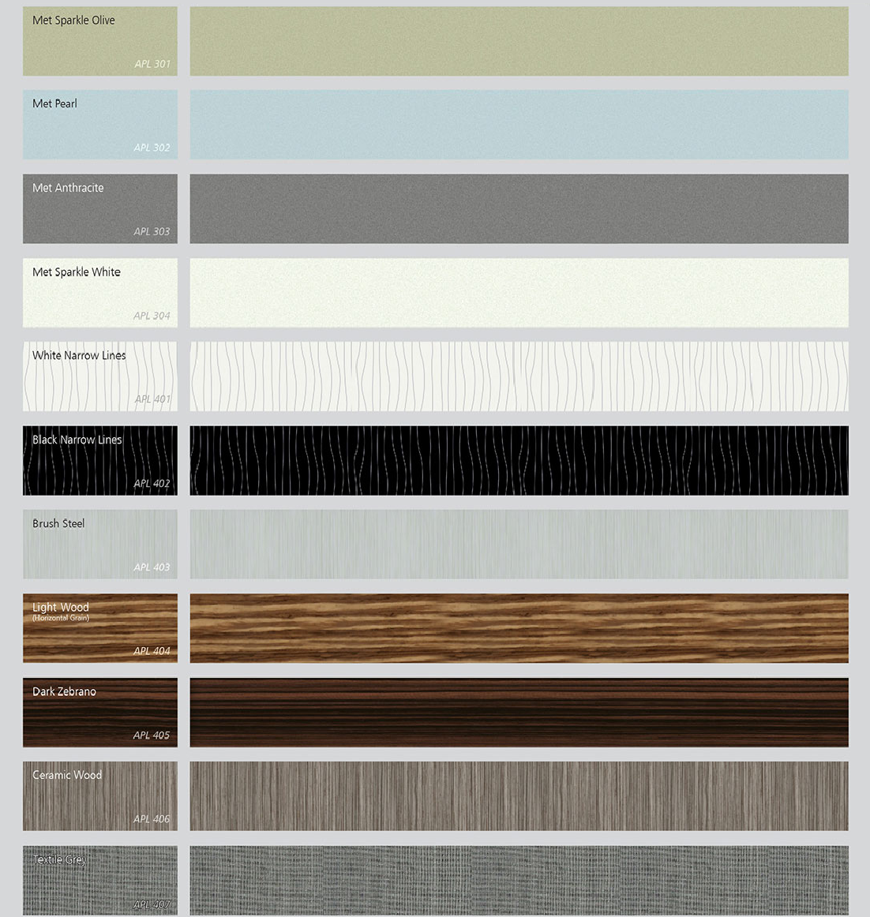
www.varenyainteriors.com Mobile/Whatsapp:+919582874024

Slide 55
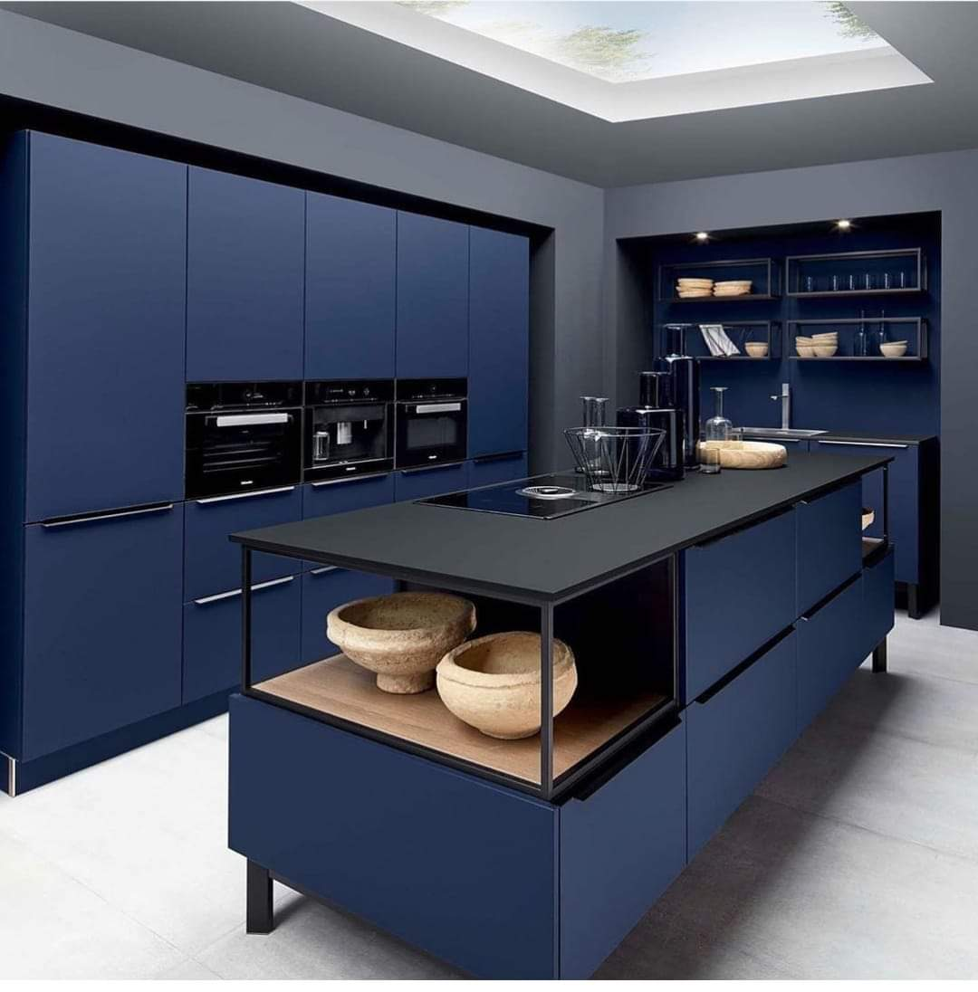
PU SHUTTER
MADE BY DESIGN COLOURS
COLOR CODE
www.varenyainteriors.com Mobile/Whatsapp:+919582874024

Slide 56
PU Shutter
PU or Polyurethane coated shutters
Available in variety of designs
Create a unique, high-end glossy finish to the kitchens
Resistant to water, impact, abrasion and industrial corrosive environment
Settle in beautifully and maintain a rich and modern look
Extremely sleek and quite easy to maintain

Slide 57




www.varenyainteriors.com Mobile/WhatsApp:+919582874024

Slide 58

www.varenyainteriors.com Mobile/Whatsapp:+919582874024

Slide 59

Address:-
Plot no. 1300, Sector -9, Gurugram-122001
E-Mail I’d- varenyainterior@gmail.com
Website:-www.varenyainteriors.com
WhatsApp/Contact No.- +91-95828-74024
+91-99537-70279

